Slide 1
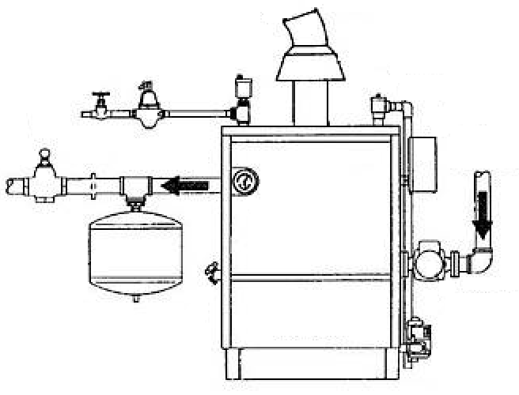

Steam : 4.192 kg/hr
LPG : 4.192 kg/hr
Error codes :
Feed Water Halt
Low Combustion
Temperature 1 : 34 ̊C
Input Water Flow :
4.192 kg/hr
Temperature 2 : 34 ̊C
Output Water Flow :
4.192 kg/hr

Slide 2
A
B
E
G
A → LPG : 4.192 kg/hr
B → Steam : 4.192 kg/hr
C → Input Water Flow : 4.192 kg/hr
D → Output Water Flow : 4.192 kg/hr
E → Temperature 1 : 34 ̊C
F → Temperature 2 : 34 ̊C
G → Error Code : 1) Feed Water Halt
2) Low Combustion
D
C
F

